Slide 1
Inshore FMAC
The evidence for a different approach to inshore fisheries management

Slide 2
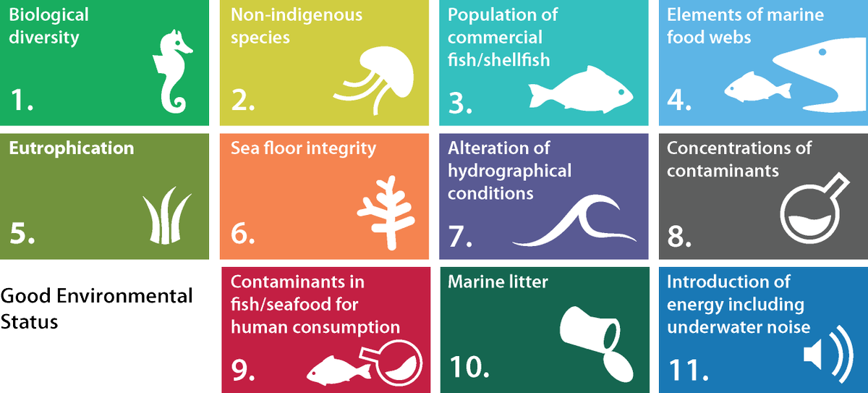
Good decisions are informed by good evidence
There will always be a requirement for more and improved evidence!
Our failure to achieve GES by 2020, the need to address issues such as the climate & biodiversity crisis and addressing spatial squeeze as well as meeting the requirements of the fisheries act compel us to reconsider how we manage our inshore fisheries

Slide 3
The Sustainability Objective
The ‘sustainability objective’ is that:
(a) fish and aquaculture activities are—
(i) environmentally sustainable in the long term, and
(ii) managed so as to achieve economic, social and employment
benefits and contribute to the availability of food supplies, and
(b) the fishing capacity of fleets is such that fleets are economically viable but
do not overexploit marine stocks

Slide 4
Other Objectives
The “precautionary objective” is that—
(a)the precautionary approach to fisheries management is applied,
(b)exploitation of marine stocks restores and maintains populations of harvested species above biomass levels capable of producing maximum sustainable yield.
The “ecosystem objective” is that—
(a)fish and aquaculture activities are managed using an ecosystem-based approach so as to ensure that their negative impacts on marine ecosystems are minimized and, where possible, reversed, and
(b)incidental catches of sensitive species are minimized and, where possible, eliminated.
The “scientific evidence objective” is that—
(a)scientific data relevant to the management of fish and aquaculture activities is collected,
(b)where appropriate, the fisheries policy authorities work together on the collection of, and share, such scientific data, and
(c)the management of fish and aquaculture activities is based on the best available scientific advice.

Slide 5
The Precautionary Objective
An approach in which the absence of sufficient scientific information is not used to justify postponing or failing to take management measures to conserve target species, associated or dependent species, non-target species or their environment

Slide 6
The inshore requires a differentiated approach to fisheries management
In the inshore there are often far more complex interactions where a wider range of species, habitats, gears, stakeholders and an often more complex mosaic of social, economic & environmental outcomes exist

Slide 7
Managing this complexity requires careful planning
Not only are there more complex interactions both at a fisheries and ecosystem level. The Inshore is where the vast majority of Scotland’s fishers are employed, and within those fisheries there are often multiple methods of fishery at a multitude of scales each capable of interacting with each other and impacting on each others livelihoods and on the environment. From a fisheries management perspective its very complex.

Slide 8
Inshore Fisheries Management Plans

Slide 9
Inclusion of over 12m vessels in VMS rollout

Slide 10
Spatial squeeze

Slide 11
The crab & lobster stock assessment should be a wakeup call
there’s too much effort on the currently available grounds

Slide 12
Mobile gear dredge & trawl fisheries
Contained within the descriptors for GES is the commercial fish indicator and the benthic habitats indicator

Slide 13
We have two requests to the IFMAC chair
First is that we discuss and gauge support for the inclusion of the over 12m demersal trawl sector in the proposed VMS rollout
Second we discuss and gauge support for the creation of a working group to progress the development of a framework for inshore FMP's for further development by the RFIG's

Slide 14
Thank you for your time

